Slide 1
Data transfer , Addressing and Arithmetic
Chapter 4

Slide 2
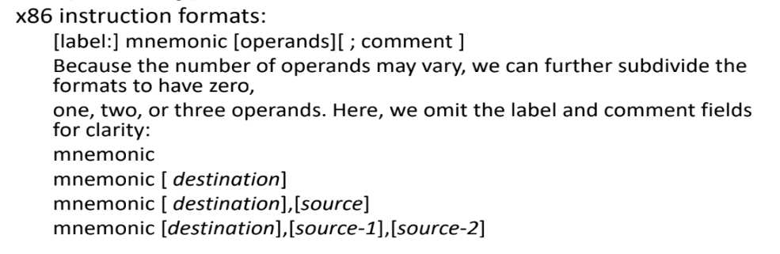
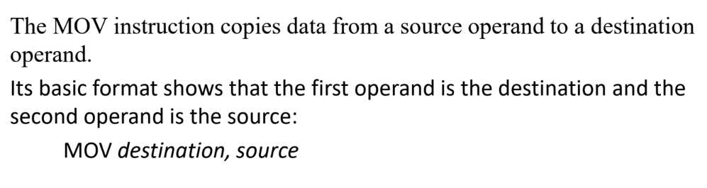
Operand Types

Slide 3
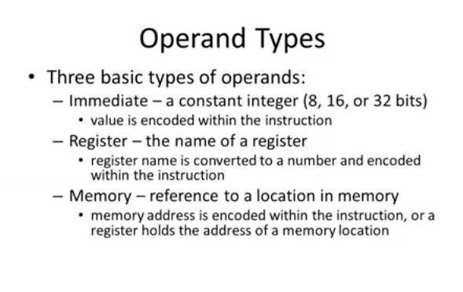

Slide 4
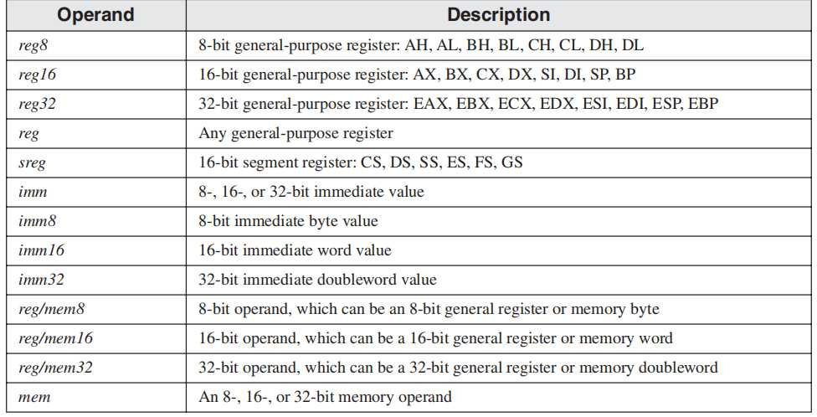

Slide 5
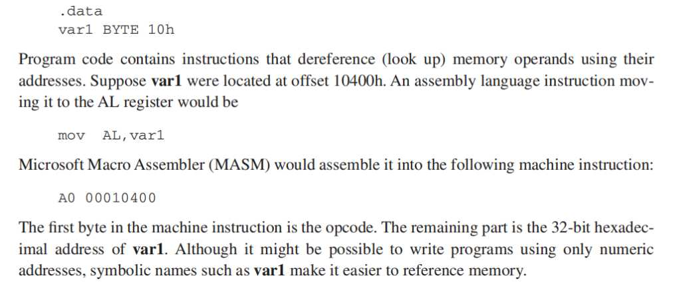
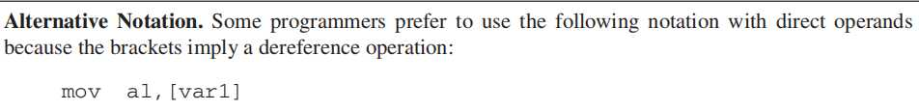
Direct Memory Operands

Slide 6
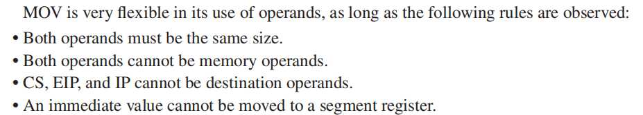
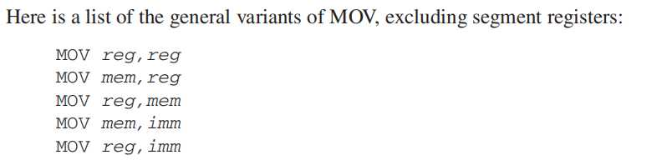
MOV Instruction

Slide 7
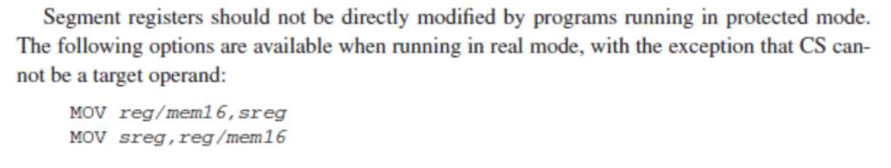
MOV Instruction

Slide 8
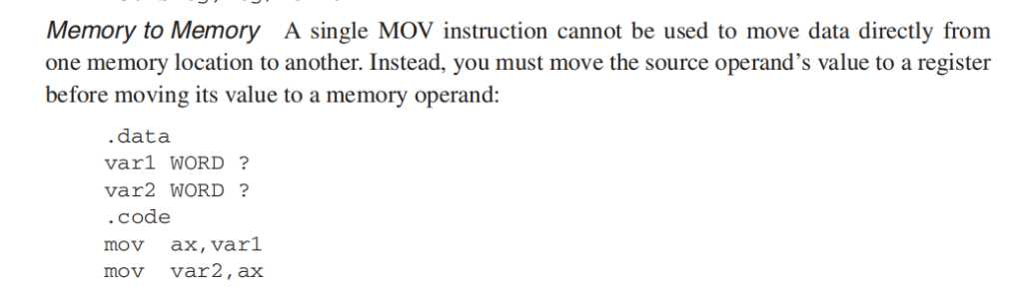
MOV Instruction

Slide 9
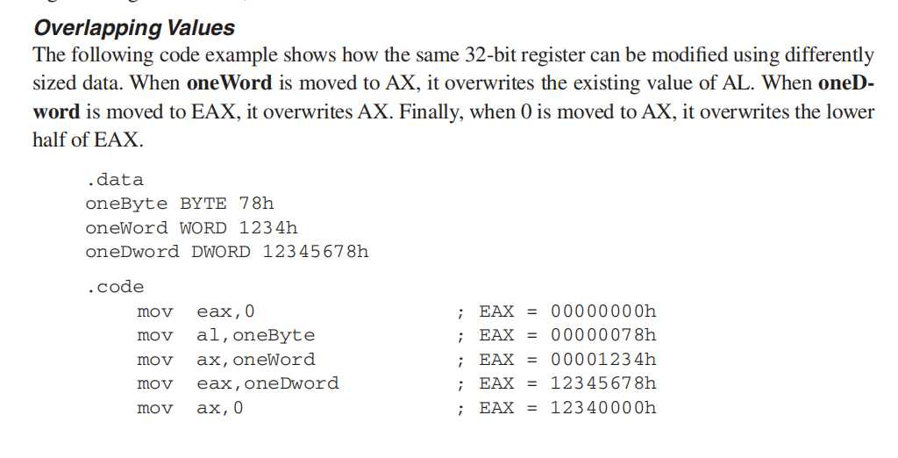
MOV Instruction

Slide 10
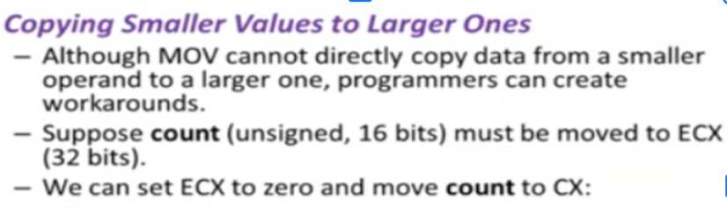
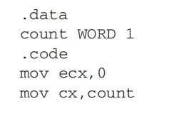
Zero / Sign Extension of Integers

Slide 11
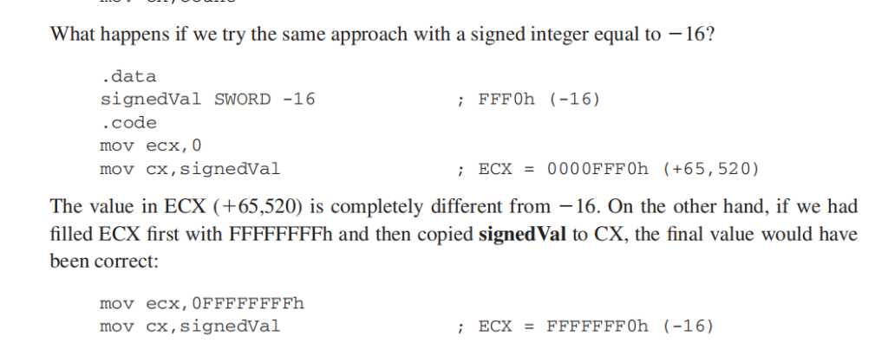
Zero / Sign Extension of Integers
16 = 0010h
0000 0000 0001 0000 b
1111 1111 1111 0000 b 2s Comp
The effective result of this example was to use the highest bit of the source operand (1) to fill
the upper 16 bits of the destination operand, ECX. This technique is called sign extension. Of
course, we cannot always assume that the highest bit of the source is a 1

Slide 12
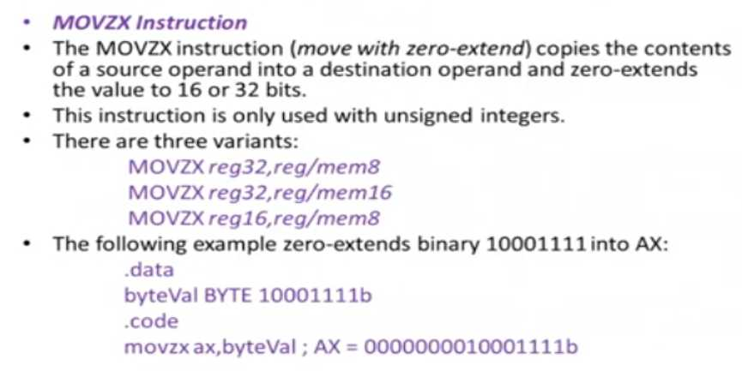
Zero / Sign Extension of Integers

Slide 13
Zero / Sign Extension of Integers

Slide 14
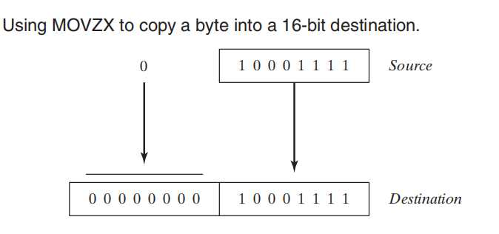

Zero / Sign Extension of Integers

Slide 15
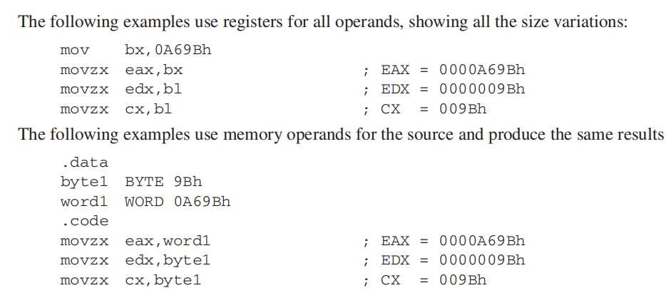
Zero / Sign Extension of Integers

Slide 16
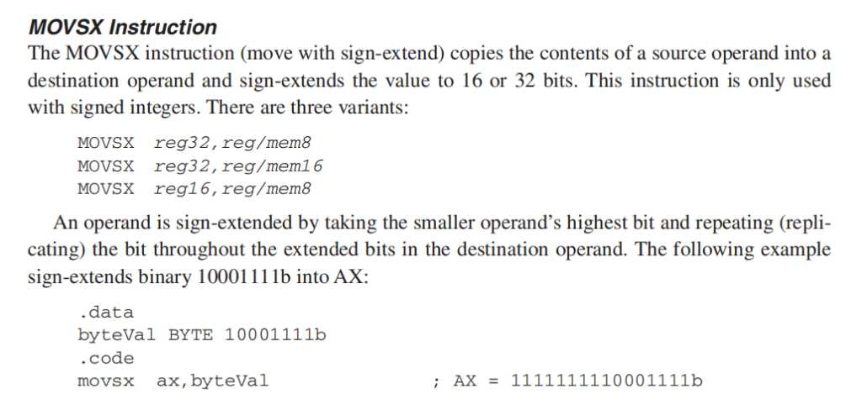
Zero / Sign Extension of Integers

Slide 17
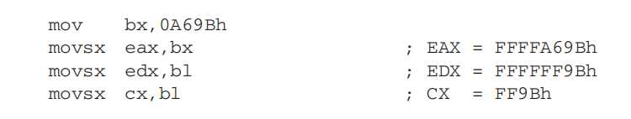
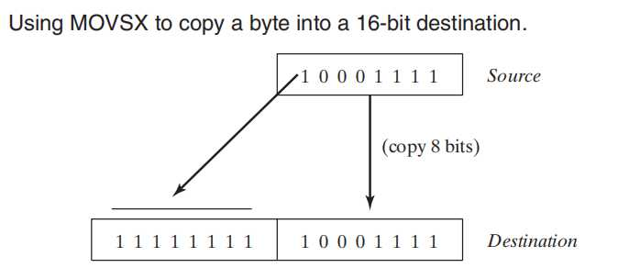
Zero / Sign Extension of Integers

Slide 18
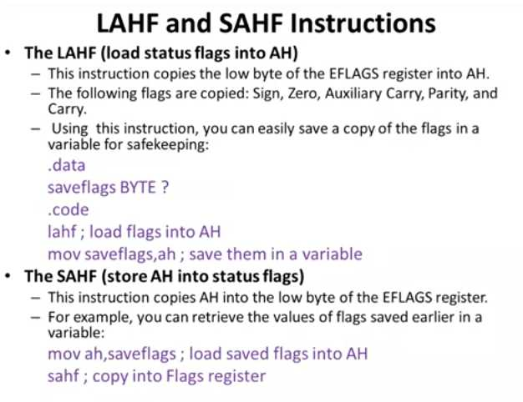

Slide 19
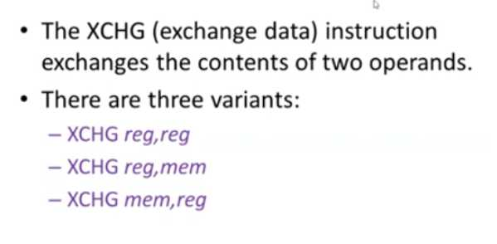
XCHG Instruction

Slide 20
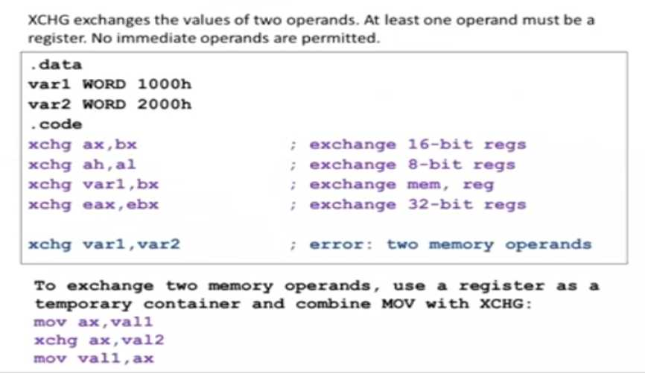
XCHG Instruction

Slide 21
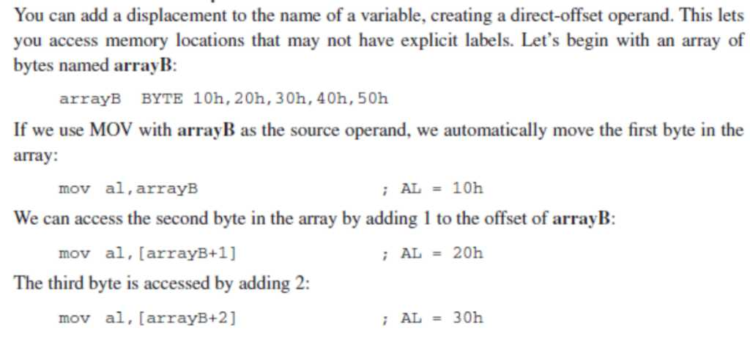
Direct-Offset Operands

Slide 22
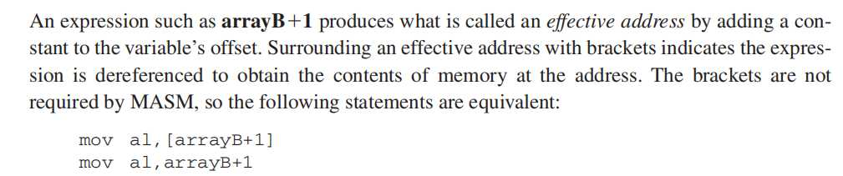
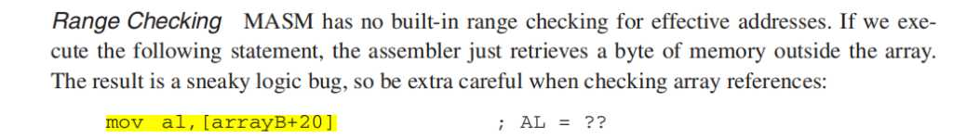
Direct-Offset Operands

Slide 23
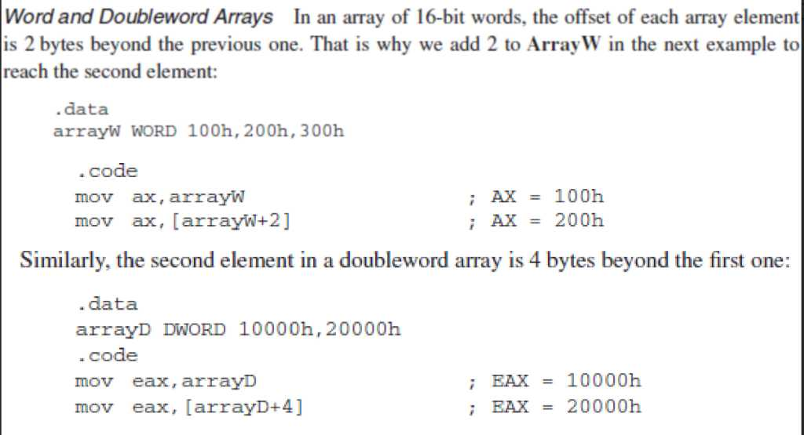
Direct-Offset Operands

Slide 24
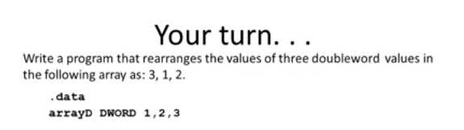

Slide 25
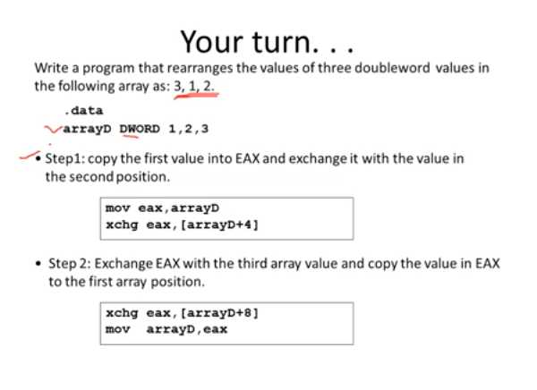
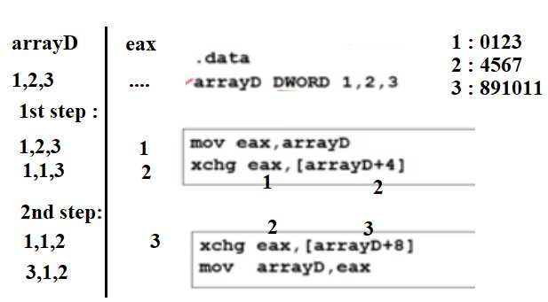

Slide 26
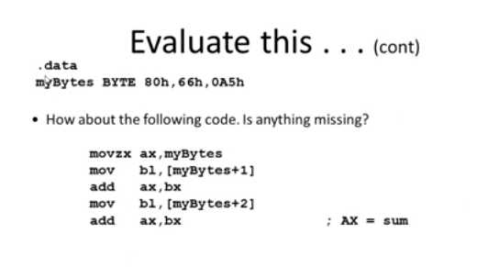

Slide 27
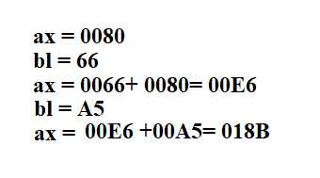

Slide 28
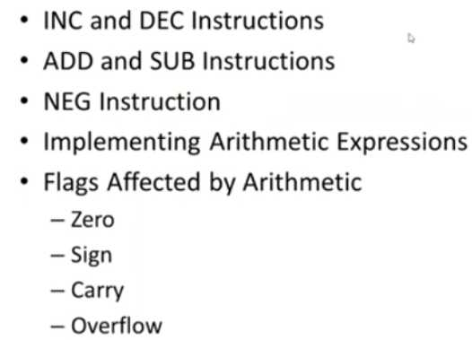
Addition and Subtraction

Slide 29
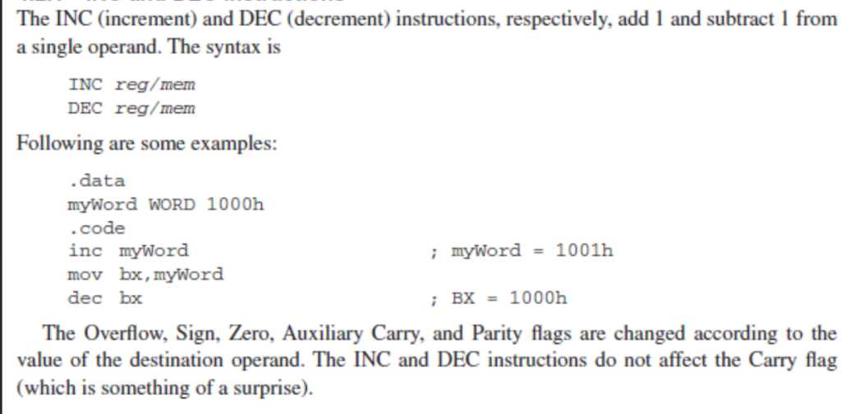
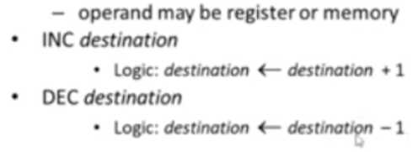
INC and DEC Instructions

Slide 30
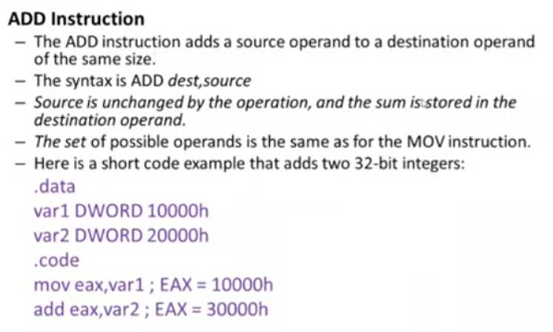
Addition and Subtraction

Slide 31
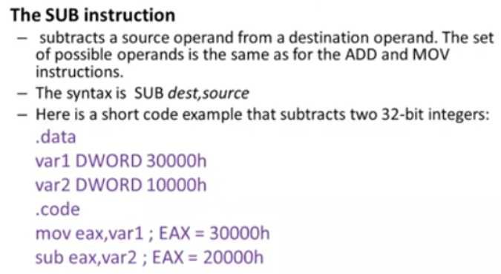
Addition and Subtraction

Slide 32
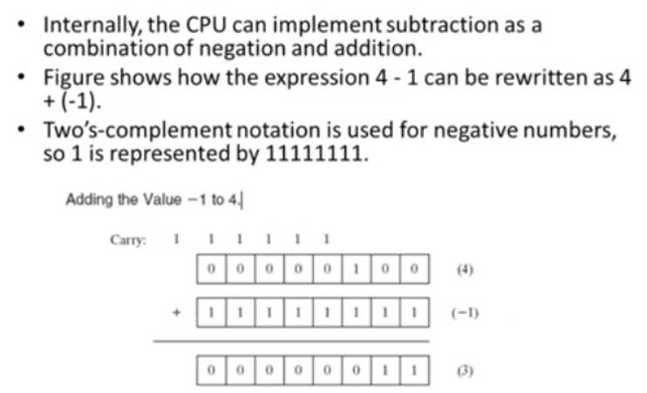
Addition and Subtraction

Slide 33
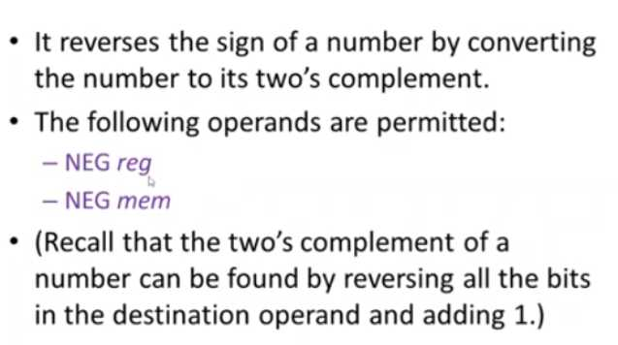
NEG Instruction

Slide 34
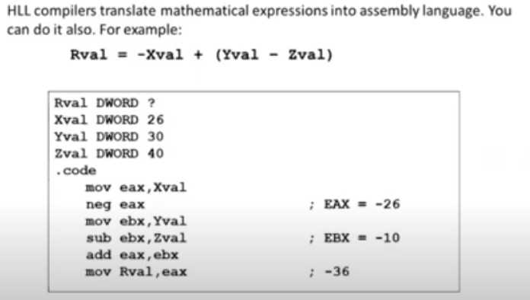
Implementing Arithmetic Expressions

Slide 35
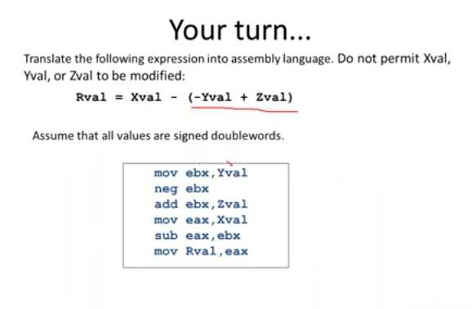

Slide 36
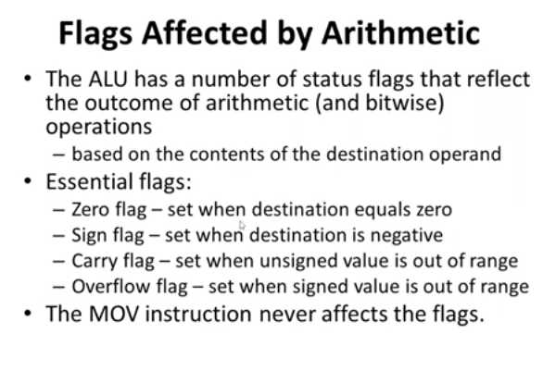

Slide 37
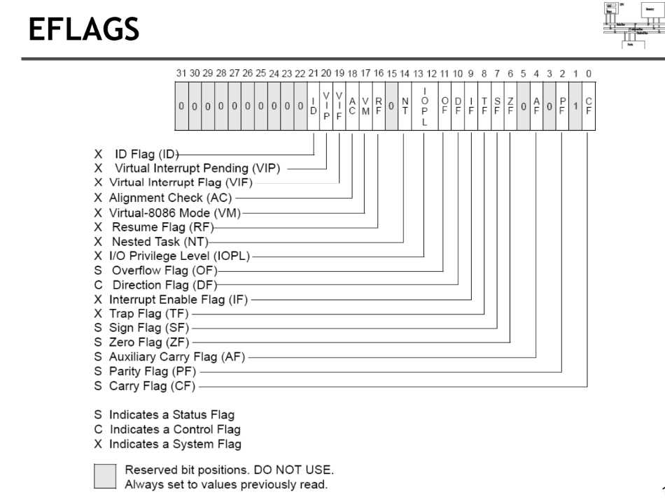

Slide 38
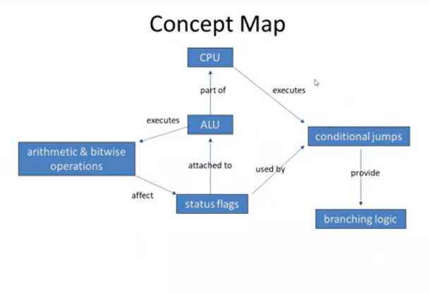

Slide 39
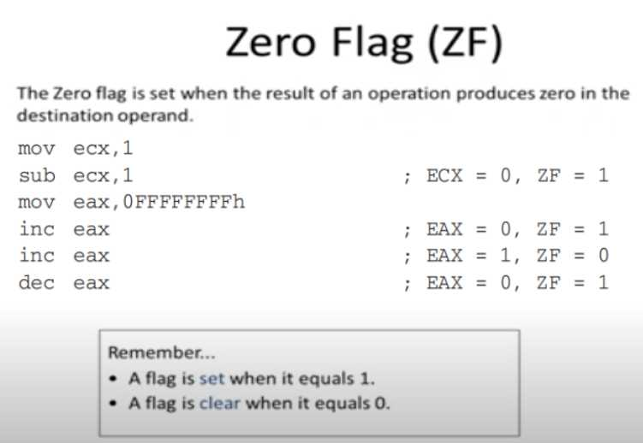

Slide 40
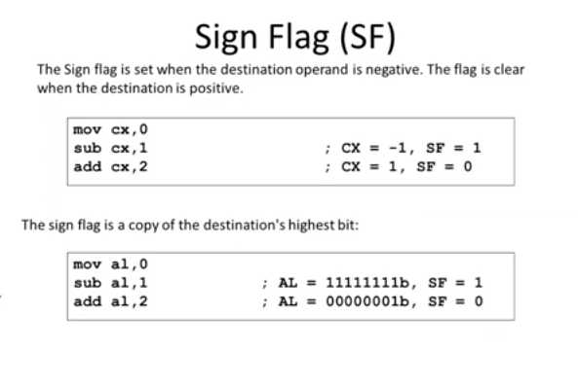

Slide 41
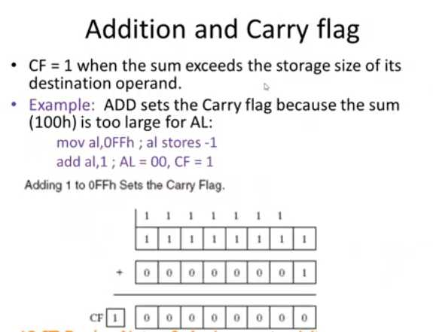

Slide 42
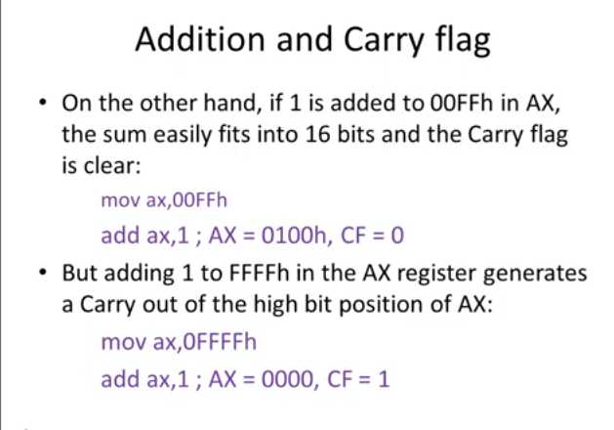

Slide 43
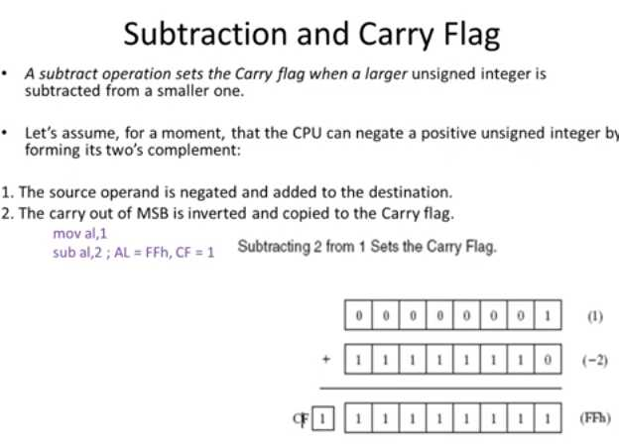

For subtraction, the Carry Flag (CF) indicates a borrow.
If the destination operand (minuend) < source operand (subtrahend), then a borrow is required → CF = 1
Otherwise, CF = 0.

Slide 44
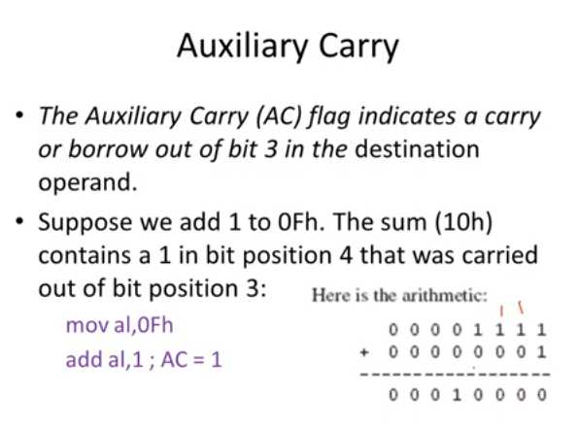

Slide 45


Slide 46


Slide 47


Slide 48


Slide 49


Slide 50


Slide 51


Slide 52


Slide 53


Slide 54

Data-Related Operators and Directives
OFFSET Operator

Slide 55

OFFSET Operator

Slide 56


Slide 57


Slide 58


Slide 59



Slide 60


Slide 61


Slide 62


Slide 63


Slide 64


Slide 65


Slide 66

TYPE Operator

Slide 67

LENGTHOF Operator

Slide 68

SIZEOF Operator

Slide 69


Slide 70


Slide 71

A common use of LABEL is to provide an alternative name and size attribute for the variable declared next in the data segment.

Slide 72


Slide 73


Slide 74


Slide 75


Slide 76


Slide 77


Slide 78


Slide 79


Slide 80


Slide 81


Slide 82


Slide 83



Slide 84

Example

Slide 85


Example

Slide 86


Slide 87


Slide 88



Slide 89


Slide 90

Nested Loop

Slide 91


Slide 92


